Slide 1
COVID:19
Education on
The virus. How to protect yourself.
What to do if you are infected.
Information about health, wellness, and resilience.
There is no time for COVID-19 fatigue.
We have to remain vigilant.
We must carefully follow community mitigation strategies.
Please see the following article with the latest information
from the CDC dated 10-29-20
https://www.cdc.gov/coronavirus/2019-ncov/community/community-mitigation.html

Slide 2
How to Best Protect Yourself
“How COVID-19 Spreads“ CDC (October 28, 2020)
‘Protect yourself and others
The best way to prevent illness is to avoid being exposed to this virus. You can take steps to slow the spread.
Stay at least 6 feet away from others, whenever possible. This is very important in preventing the spread of COVID-19.
Cover your mouth and nose with a mask when around others. This helps reduce the risk of spread both by close contact and by airborne transmission.
Wash your hands often with soap and water. If soap and water are not available, use a hand sanitizer that contains at least 60% alcohol.
Avoid crowded indoor spaces and ensure indoor spaces are properly ventilated by bringing in outdoor air as much as possible. In general, being outdoors and in spaces with good ventilation reduces the risk of exposure to infectious respiratory droplets.
Stay home and isolate from others when sick.
Routinely clean and disinfect frequently touched surfaces.
Pandemics can be stressful, especially when you are staying away from others. During this time, it’s important to maintain social connections and care for your mental health.”
Most recently the CDC website shared the virus that causes COVID-19 most commonly spreads between people who are in close contact with one another (within about 6 feet or about 2 arm lengths for a cumulative 15 minutes in 24 hours). (CDC Updates its Guidelines for Close COVID-19 Contact After Prison Guard Gets Infected.” CNN, October 22, 2020)

Slide 4
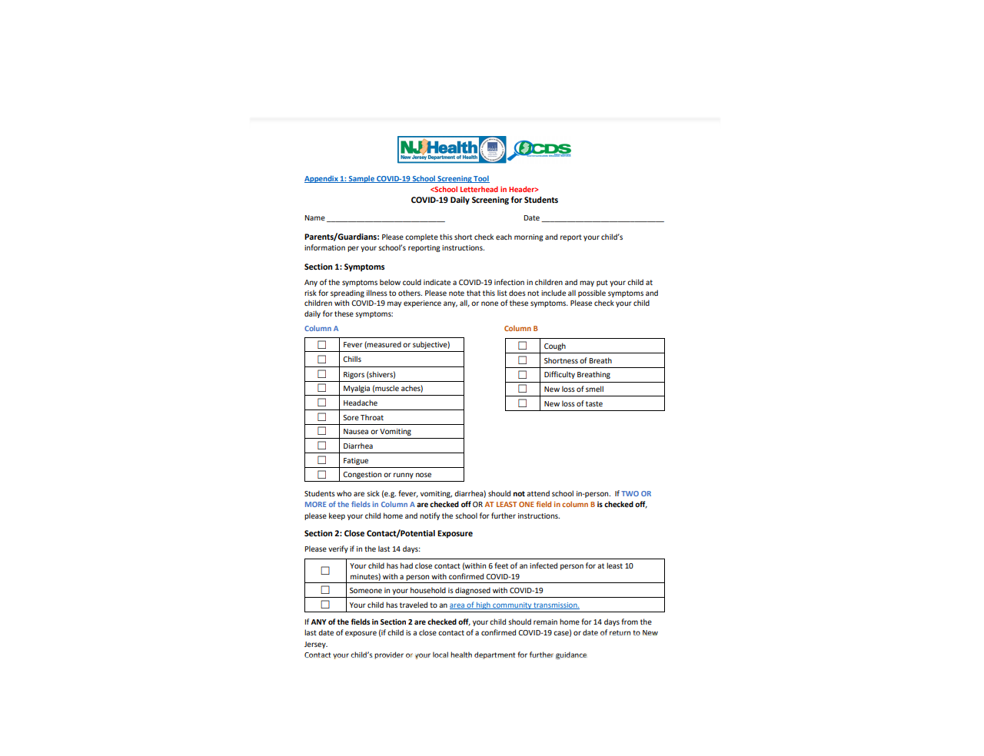

Slide 6
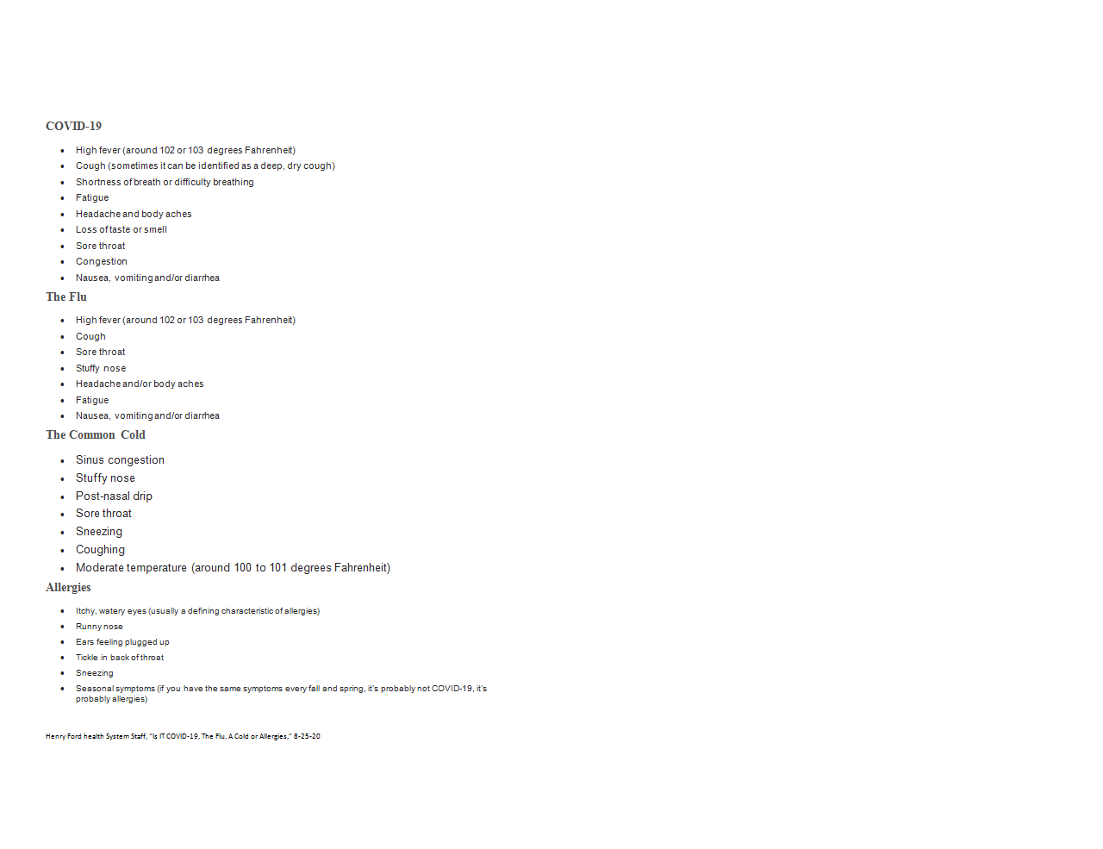

Slide 7
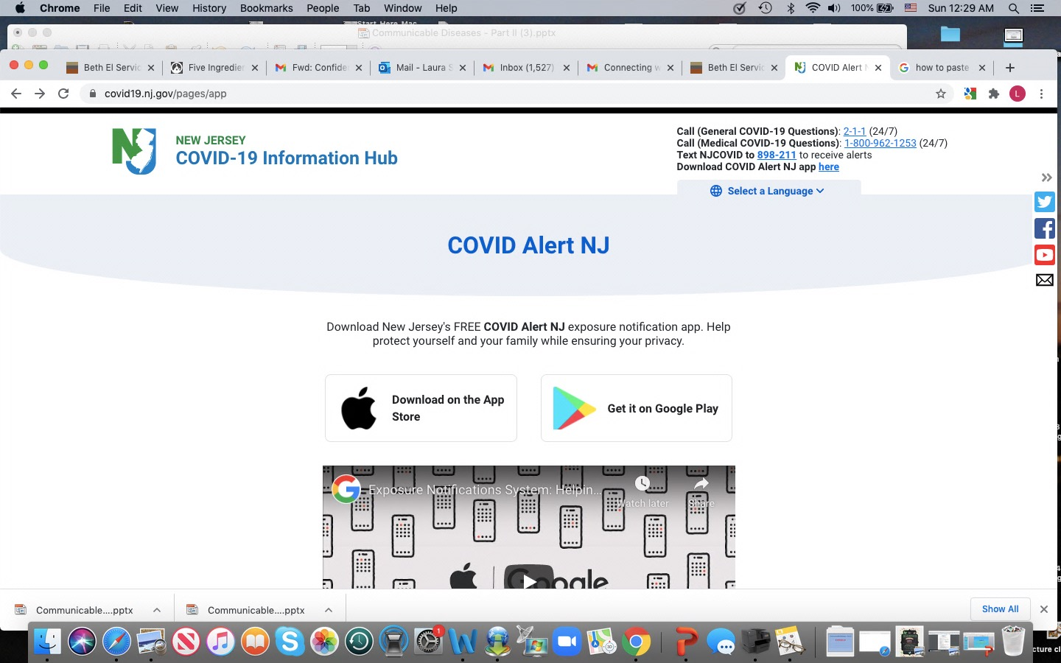

Slide 8
Quarantine and Isolation
Quarantine keeps someone who was in close contact with someone who has COVID-19 away from others (within about 6 feet, or about 2 arm lengths for a cumulative 15 minutes in 24 hours). And, it is considered an exposure even if a mask was worn.
If you had close contact with a person who has COVID-19
You were exposed to the virus. Stay home for 14 days after your last contact since it can take 2-14 days to develop symptoms.
Take your temperature twice a day and watch for symptoms.
Receiving negative test results does not reduce the length of time needed for quarantine.
If possible, stay away from people who are at higher risk for getting very sick from COVID-19.
CDC (7-20-20 and updated with revisions made on October 21, 2020)
Isolation is when you have the virus, based on symptoms or a positive test.
If you are sick and think or know you have COVID-19
Stay home for at least 10 days since symptoms first appeared plus
At least 24 hours fever-free without fever reducing medication and
Symptoms have improved.
If your virus was very serious, you may have to stay home for at least 20 days.
If you tested positive for COVID-19, but do not have symptoms
Stay home until after 10 days have passed since your positive test.
If you live with others, stay in a specific “sick room” and away from people and pets. Use a separate bathroom, if possible.

Slide 9
Tim E

Slide 10
Take Care of Yourselves:
Common factors associated with resilience in the face of adversity and trauma include:
Key Resilience Factors
• Sense of control
• Sense of meaning and purpose
• Spirituality
• Self-awareness and emotional regulation skills
• Social support
• Healthy coping style
• Humor and optimism
• Cognitive flexibility
• Positive thinking
• Adaptability to change
“Educator Resilience and Trauma-Informed Self-Care” (April 2020), Center on GREAT TEACHERS & LEADERS at the American Institutes for Research, https://gtlcenter.org/sites/default/files/Educator-Resilience-Trauma-Informed-Self-Care-Self-Assessment.pdf-Trauma-Informed-Self-Care-Self-Assessment.pdf

Slide 11
Building Resilience, Preventing Burnout by Elena Aguilar
1. Care for your body. Prioritize sleep above all else. Aim for eight hours a night. There are many connections between sleep and emotional wellness. Eat nutritious food. Move your body.
2. Carve out downtime and honor it religiously. Make sure you take at least one weekend day off. During the week, be sure to stop working by 8 pm. You need to rest. Working yourself to the bone or martyring yourself to the cause is useless. It won’t ultimately serve you or your students.
3. Build in micro-moments of renewal during the day. Every hour, or at least a couple times a day, sit still for one minute. Close your eyes. Imagine all your stress draining out of the palms of your hands and the soles of your feet.
4. Cultivate realistic optimism. Resilient people are optimistic. Remember that challenge and struggle are temporary, not permanent. Being optimistic has nothing to do with being a Pollyanna or denying reality. It’s about holding to the belief that positive change is always possible. It’s about seeing the glass as half full and half empty.
5. Hold a growth mindset. Whatever the challenge is that you’re facing—and for teachers there are endless challenges—ask yourself, “What can I learn from this?” This question puts you in a learner mindset and reminds you that you can always learn. Just because you can’t do something today doesn’t mean you won’t be able to do it next week.
6. Anchor in your why. Resilient people are driven by purpose. Why are you teaching? What do you want your legacy to be? What motivates you to get up every day? Get clear on your why and use it as an anchor.

Slide 12
7. Be patient. Patience is a disposition of the resilient. Be patient with yourself, your students, your colleagues, and your administrators. Patience has nothing to do with complacency, it’s just an acceptance that we aren’t the master rulers of time and all things and that we can only do what we can do.
8. Have tea or coffee with a colleague [virtually]. Build your community. In moments of stress, those who thrive are those who strengthen relationships with others.
9. Learn to see what you’re doing well. When we get exhausted, and when we’re trying really hard to do something well, we have a hard time seeing what’s working. Maybe you have an instructional coach, mentor, or administrator who helps you with this, but it’s equally important for you to hone your ability to spot your own successes. After all, you’re the only one watching you every day. Spend a day being your own best friend, ban your critical self-talk from uttering a word all day, and spend the day narrating your successes: “You got your first-period class focused on the ‘Do Now’ within 30 seconds! You weren’t triggered by Johnny’s attitude! You ate breakfast!”
10. Ask for help. When you’re really struggling, ask colleagues, friends, neighbors, supervisors, mentors, coaches, and partners for help. Ask for all the kinds of help you need. Tell people you’re having a hard time. Keep asking until you get what you need. And if you’re ever in doubt, even the tiniest bit, about your mental or physical well-being, please seek professional help. Rates of depression and anxiety among teachers are higher than in the general public. Teaching is extremely stressful. If in doubt, get help.
Lucas Educational Foundation
Teacher Wellness, (Edited version), October 17, 2017
https://www.edutopia.org/article/building-resilience-preventing-burnout

Slide 13
Final Thoughts
The virus that causes COVID-19 most commonly spreads between people who are in close contact with one another (within about 6 feet, or 2 arm lengths) for a cumulative 15 minutes in 24 hours.
It spreads through respiratory droplets or small particles, such as those in aerosols, produced when an infected person coughs, sneezes, sings, talks, or breathes.
These particles can be inhaled into the nose, mouth, airways, and lungs and cause infection. This is thought to be the main way the virus spreads.
Droplets can also land on surfaces and objects and be transferred by touch. A person may get COVID-19 by touching the surface or object that has the virus on it and then touching their own mouth, nose, or eyes. But, spread from touching surfaces is not thought to be the main way the virus spreads.
Please do not let yourself have “COVID Fatigue.” Maintain your vigilance. Continue to wear your masks, physically distance, and frequently wash your hands.
Please consider having a flu shot this year. And, when the vaccine for COVID-19 is approved, make a thoughtful, fact-based decision on whether you will take the vaccine.
Take yourself forward to the year 2025. Hopefully this pandemic will be just a memory. Consider what you will remember. Will you have changed in some ways? How did you appreciate the positives – life, family, friends, and did you experience cherished memories? How did you help yourself get stronger? Did you help change the world in some small way?
In five years, if all goes well, it is hoped your story looking back will be meaningful, heartwarming, and include some wonderful memories that make you smile.
And, finally, as we get through this time, we will continue to celebrate life - with laughter, love and support from family and friends.
Please stay healthy, strong, and safe!

Slide 14
This is a good overview of the latest information about COVID-19 from Consumer Reports.
Corona Virus Resource HUB, Consumer Reports 10-20
https://www.consumerreports.org/coronavirus/coronavirus-covid-19-updates/
Please remember we are all together, and we will be here for each other.
Laura W. Sacks, RN
School Nurse
Orange Preparatory Academy
November 2020
.

